Slide 1

L2 Functional Safety
Z. Gu 2021
Acknowledgement: some materials based on Udacity Self Driving Car Engineer Nanodegree MOOC

Slide 2
Outline
Introduction to functional safety
Hazard Analysis and Risk Assessment (HARA)
Functional Safety Concept
Technical Safety Concept
Functional Safety for Hardware and Software
Notes:
Safety plan
The safety plan gives an overview of how you are going to achieve a safe system. A few of the major elements include:
what system is under consideration
the goal of the project
what steps will be taken to ensure safety
the roles and personnel involved in the project
the project timeline

Slide 3
Vocabulary: Fault, Failure, Hazard and Risk.
A fault is when something inappropriate happens to the system, such as a defect or unexpected behavior.
A fault can lead to a failure, which is synonymous with a malfunction. Failure means that the system has stopped working properly. The system is no longer doing what it is supposed to do.
A failure could lead to a hazard. A hazard is a situation that could cause injury to a person or harm a person's health. If a system fails, the situation is potentially hazardous.
Hazards have different levels of risk.
Examples:
If a resistor in your car radio hardware breaks (fault), the radio won't turn on (failure). You won't get to listen to music, but that won't cause you bodily injury or harm. So this is a hazard with low risk.
If a resistor in the power steering hardware breaks (fault), the power steering could fail (failure). If you were driving at high speed, then you might get injured quite badly. So this is a hazard with high risk.
Notes:
For example, if a resistor in your car radio hardware breaks, that could lead to a fault. The radio won't turn on, so the radio has failed. Does the failure lead to a hazardous situation? Probably not. You won't get to listen to music, but that won't cause you bodily injury or harm.
If a resistor in the power steering hardware breaks, the power steering could fail. If you were driving at high speed, then you might get injured quite badly. So this is a hazardous situation with high risk.
Faults leads to failures. A failure leads to a hazard. A hazard has a certain a level of risk.

Slide 4
Notions of Safety in the Automotive Context
Functional Safety
HW/SW not working according to specification
Safety of intended functionality
Hazardous situation due to lack of specification
Safety in use
Hazardous misuse/misunderstanding
Active/passive safety
Accidents and their impact
Security
Inherently affects safety
Notes:
For automotive systems:
ISO 26262 standard defines 5 Automotive Safety Integrity Levels (ASIL) (QM, A, B, C, D)
Current automotive industry does not have a third-party safety certification process (no counterpart of FAA for cars), but this may change with the advent of self-driving cars

Slide 5
Functional Safety
The term "functional" comes from a branch of systems engineering called requirements engineering. Systems engineering separates requirements into:
Functional requirements - what your system is supposed to do; in other words, the system's functions, with the form X system shall do Y.
e.g., "The turn signal system shall turn on an indicator light telling the driver that the system is active".
Non-functional requirements - how the system should behave, e.g., how reliable is the system? With the form X system shall be Y.
e.g., "The turn signal system shall be available when the vehicle ignition switch is in the on position“.
It does not specify the function of the turn signal system, only its availability, hence it is not a functional requirement
Functional safety looks at what happens when the system does something that it was not supposed to do, which is called a malfunction. You will be adding new engineering requirements to the vehicle design in order to ensure safe systems.
Notes:
Functional safety is the part of the overall safety of a system or piece of equipment that depends on automatic protection operating correctly in response to its inputs or failure in a predictable manner (fail-safe). (from Wikipedia)

Slide 6
Automotive Safety vs. Automotive Functional Safety
Automotive functional safety is only concerned with E/E (Electrical/Electronic) system malfunctions. It is just one part of overall vehicle safety.
Vehicles have a number of different systems including E/E, hydraulic, mechanical and chemical. There are a variety of other automotive standards covering topics about safety that do not concern E/E system.

Slide 7
Functional Safety vs. Nominal Performance
Functional safety does not look at nominal performance. Nominal performance issues can lead to safety problems, but nominal performance is not part of the functional safety standard.
e.g., nominal performance of an automatic braking system could be “a vehicle traveling 60 miles per hour should come to a complete stop in 5 seconds.”
Functional safety does not determine whether or not the vehicle brakes within 5 seconds. Instead, functional safety would look at malfunctions like
If the braking function is not engaged when it is supposed to
If the braking function is engaged when it isn't supposed to
if the system brakes too hard causing injury to the driver.

Slide 8
Quiz: Which of the following is part of a functional safety analysis?
1. A mechanical seatbelt restraint system could fail, and a passenger would be injured in an accident
2. Testing to see if a backup camera actually meets its technical specifications of a depth perception of 20 feet
3. There is a potential that a software error could cause the parking brake to engage at high speeds
4. a car battery might catch on fire because of a chemical reaction
ANS: 3

Slide 9
Functional Safety Analysis
Safety = absence of unreasonable risk
What is functional safety analysis?
Identify high-risk situations
Lower risk to reasonable levels
It has 3 steps:
Identify hazards in a passenger vehicle’s Electric/Electronic (E/E) system that could cause physical injury or damage to a person's health
Evaluate the risk of the hazardous situation so that we know how much we need to lower the risk
Via systems engineering, prevent accidents from occurring by lowering risk to reasonable levels.
Notes:
Systems engineering helps you figure out what your vehicle needs to do and what your vehicle design needs to look like in order to remain safe.

Slide 10
What Level of Risk is Reasonable?
Functional safety focuses on keeping risks below society's current threshold.
The history of seat belts provides a great example of how society measures risks. It took almost a century for countries to require seat belt use.
Many people consider Karl Benz to have invented the automobile around 1885. Seat-belts didn't start appearing until the 1920s when doctors began installing them in their own vehicles. It wasn't until the 1950s that car companies offered seat belts as optional equipment. And then it took until the end of the 1950s for seat belts to become standard equipment.
In 1968, the United States passed legislation requiring all vehicles to come with safety belts. Then in 1970, Australia became the first country to require seat belt use. In 1984, New York was the first state in the United States to pass similar legislation. Today, can you imagine purchasing a car with no seat belts? By the measure of contemporary society, driving without a seatbelt is an unreasonable risk. But in the past, driving without a seatbelt was considered reasonable by society's standards.
Note that functional safety only looks at malfunctions related to E/E systems. Typical seat belts are mechanical devices, hence they would not be considered part of automotive functional safety. However, Some modern seat belts that contain electrical components should be considered part of functional safety.

Slide 11
Identifying Hazards
Three general causes for accidents
Human error
The National Highway and Transportation Safety Administration estimates that 94% of car accidents in USA involve human error.
Technology error
Software bugs are a major source of technology error.
Human-technology interaction error
Whenever a human and a machine share control of a system, extra care needs to be taken when evaluating safety; the boundary between what the human is supposed to do and what the machine is supposed to do needs to be clear.
Drivers need to understand the warning signals coming from ADAS systems; interfaces need to make it clear when the vehicle expects us to take over.
Some companies (e.g., Waymo) has argued that low-levels of automation are not safe, since it is unrealistic to expect drivers to keep their hands on the steering wheel and be prepared to take over for long durations of time.
High levels of automation (L4/L5) will remove hazards due to human-technology interactions.
Notes:
Autonomous vehicle technology is so new that standards like ISO 26262 do not yet even consider certain issues related to self-driving cars such as machine learning algorithms

Slide 12
Quiz
Classify the causes for the following
1. A software bug causes the vehicle to accelerate inadvertently.
2. A driver goes too fast around a curve and falls off the road.
3. A radar-based vehicle detection system is too sensitive and buzzes even when a crash is not imminent. The driver ignores warnings, which could lead to an accident if a crash were imminent.
ANS: 1. Technology error; 2. Human error; 3. Human-technology interaction error

Slide 13
ASIL (Automotive Safety Integrity Level)
The ISO 26262 standard defines 4 ASILs: ASIL A, ASIL B, ASIL C and ASIL D.
ASIL D represents a hazardous situation with the highest risk whereas ASIL A represents lower risk. ASIL is a key term in automotive functional safety.
There is one more level of risk below ASIL A called QM (Quality Managed), which means that development according to accepted quality principles is sufficient to reduce risk. QM is not covered by ISO 26262; it is covered by another standard IATF 16949.
ASILs are determined by Hazard Analysis and Risk Assessment (HARA), discussed later.

Slide 14
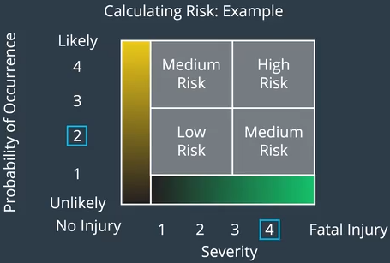
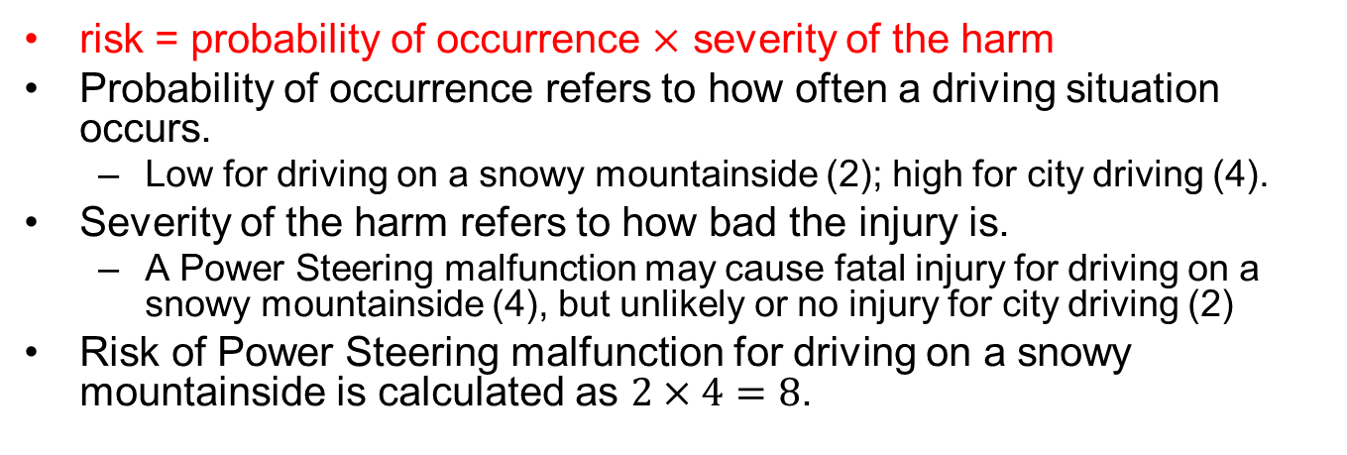
Evaluating Risk
risk = probability of occurrence $×$ severity of the harm
Probability of occurrence refers to how often a driving situation occurs.
Low for driving on a snowy mountainside (2); high for city driving (4).
Severity of the harm refers to how bad the injury is.
A Power Steering malfunction may cause fatal injury for driving on a snowy mountainside (4), but unlikely or no injury for city driving (2)
Risk of Power Steering malfunction for driving on a snowy mountainside is calculated as $2×4=8$.

Slide 15
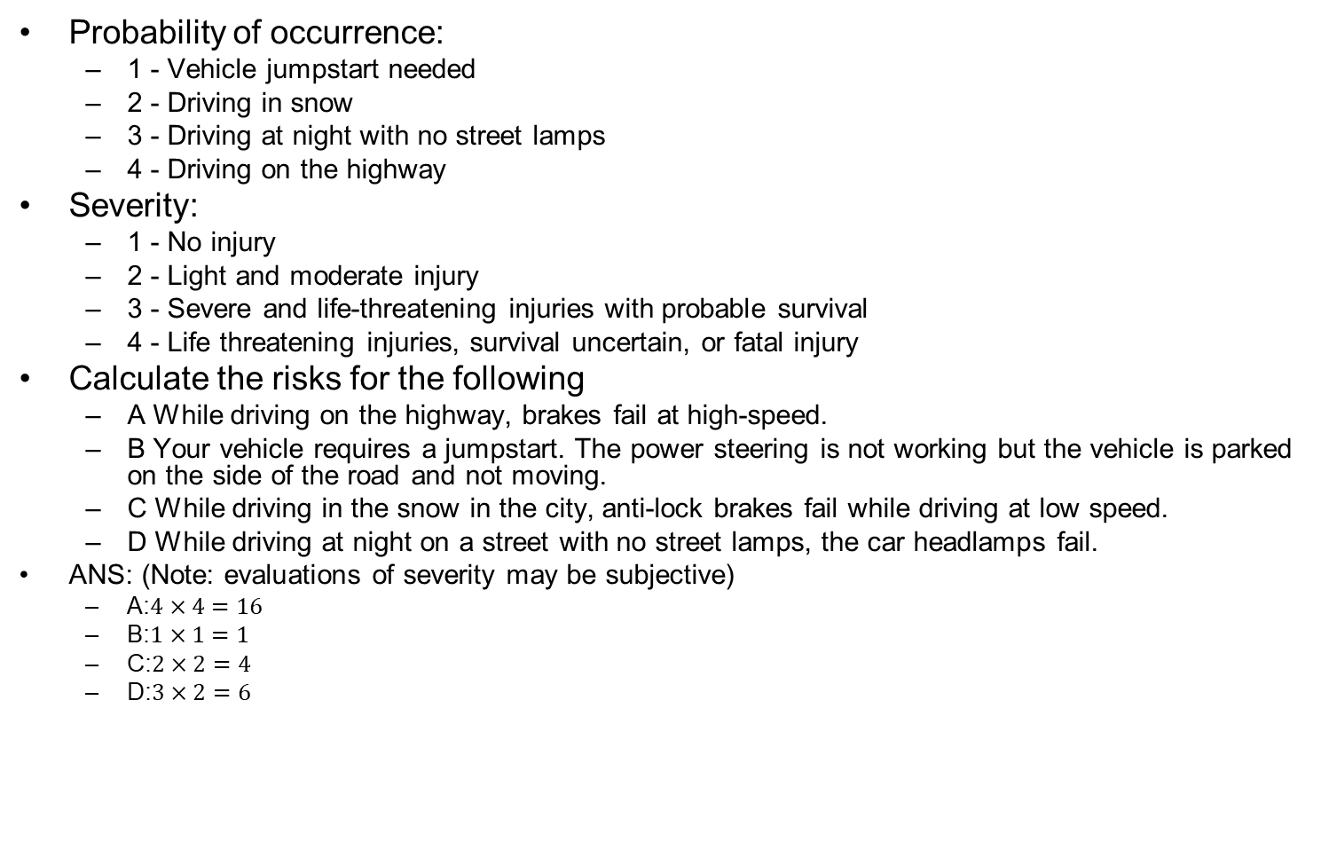
Quiz
Probability of occurrence:
1 - Vehicle jumpstart needed
2 - Driving in snow
3 - Driving at night with no street lamps
4 - Driving on the highway
Severity:
1 - No injury
2 - Light and moderate injury
3 - Severe and life-threatening injuries with probable survival
4 - Life threatening injuries, survival uncertain, or fatal injury
Calculate the risks for the following
A While driving on the highway, brakes fail at high-speed.
B Your vehicle requires a jumpstart. The power steering is not working but the vehicle is parked on the side of the road and not moving.
C While driving in the snow in the city, anti-lock brakes fail while driving at low speed.
D While driving at night on a street with no street lamps, the car headlamps fail.
ANS: (Note: evaluations of severity may be subjective)
A:$4×4=16$
B:$1×1=1$
C:$2×2=4$
D:$3×2=6$

Slide 16
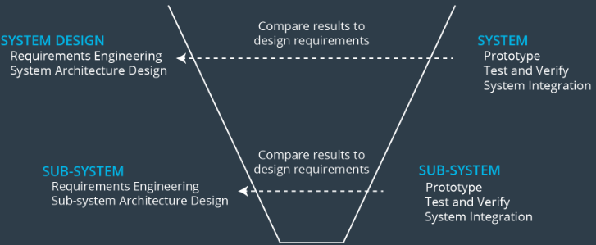
Reducing Risk with Systems Engineering
The Systems Engineering V-Model
1. Requirements engineering
2. System architecture design and allocating requirements
3. Testing and verification
4. System Integration
The top part of the V represents the entire vehicle as a single system. As you traverse down the left side of the V, you focus on smaller and smaller subsystems. As you go up the right side of the V, you integrate your subsystems into larger and larger systems.
At the top left, you start with a bird's eye view of your entire vehicle. As you move down the left side, you start to split your vehicle into subsystems like climate control, entertainment system, steering system, braking system, etc. You then define requirements and system architectures for each sub-system.
Then you focus on a sub-system, like the climate control system, and break down the climate control system into its own sub-systems like the electronic control unit, the temperature sensor, the fan, the air filter, etc. Each sub-system will have its own design requirements and design architecture.
You can connect the right side of the V and the left side of the V. For every prototype you make or test you run, you can check back to see if the results match the design specifications.
Notes:
As you travel down the left side of the V model, you will generally take requirements from the previous step and then refine them in the current step. It makes sense that requirements would be refined at each level; as you travel down the V, you dive into sub systems with increasing detail.
Then you start to move up the right side of the V. First, you'll test your temperature sensor to make sure it functions correctly according to its design requirements. You will do the same for all of the air conditioning subsystems. Then you will integrate the temperature sensor with the electronic control unit and run more tests to make sure they play well together.
You move up the V until you have a complete air conditioning system that functions according to its design specifications. You move up the V and integrate the air conditioning system with the other electronic systems in the vehicle, and then you test again. Eventually, when you get to the top right side of the V, you will have a complete car ready for production!
For every design step on the left side of the V, there is a corresponding test and integration step on the right side of the V. You test your system and then go back and see if the test results match the design requirements and specifications. The correspondence between the left and rights sides of the V is one of the advantages of the V model.

Slide 17
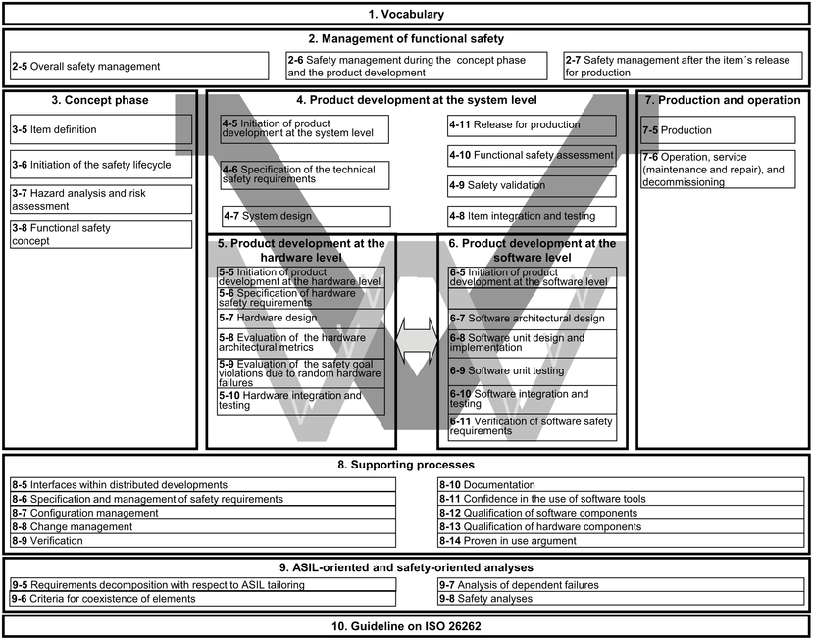
ISO 26262 Standard Document
Notes:
Standard defines Automotive Safety Integrity Levels (ASIL)
ASIL-D most stringent, ASIL-A least stringent

Slide 18
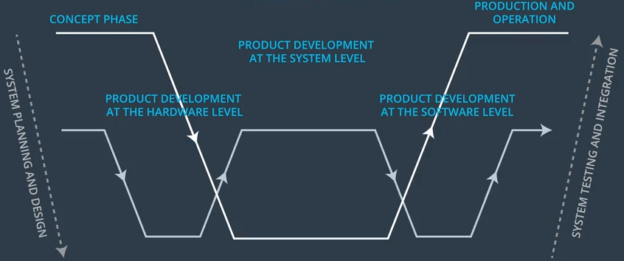
ISO 26262 V Model
ISO 26262 compliance is not legally required, but highly desirable.
Higher up in the V model represents integrated systems
The big basin (“flat-down-flat-up-flat” line).
Lower down in the V model represents subsystems
Two small basins (the “flat-down-flat-up-flat-down-flat-up-flat” line)
Left small basin for hardware development; Right small basin for software development;
Downward arrows on the left side of each basin represent specifying requirements and designing a system architecture.
Upward arrows on the right side of each basin represent prototyping, testing and integration.
Notes:
ISO 26262 compliance is not legally required. But most if not all automotive companies and automotive parts suppliers strive to make their products compliant with the standard. The standard provides a methodical, state-of-the-art framework for ensuring a safe electrical/electronic system.
Vocabulary
This section contains definitions of each section of the complete ISO 26262 V model for your reference. The functional safety module goes into depth about some of these sections: item definition, hazard analysis and risk assessment, functional safety concept, technical safety concept, hardware and software development:
Management of Functional Safety
Here, the standard discusses overall planning. Planning involves designing a safety plan, which you will learn about in the Safety Plan lesson.
Concept Phase
The concept phase contains four parts:
Item definition The item definition specifies which vehicle system is being considered. The Hazard Analysis and Risk Assessment lesson goes into more depth about item definition.
Initiation of the safety lifecycle If your project only involves modifying an existing system, you figure out which parts of the functional safety will be affected. That way, you do not have to repeat work that was already done.
Hazard analysis and risk assessment In the hazard analysis and risk assessment (HARA), you figure out situations in which your system could malfunction and then evaluate risk. The output of the HARA are high level engineering requirements called safety goals.
Functional safety concept In this section, the safety goals are refined into safety requirements. These safety requirements are then allocated to the appropriate parts of the item's architecture.
Product development at the system level
This is the main design phase. You develop a technical solution that leads to a safe system. In this section, you specify technical safety requirements, system architecture and the system design according to the left side of the V model.
Then you test, integrate, verify and validate your system according to the right side of the V model.
Product development at the hardware level
Based on the system level technical requirements from the previous step, you develop the hardware. The hardware development process has its own V model; hardware design happens on the left side of the branch. The right side of the V model includes integration and testing.
Product development at the software level
Again, based on the system level technical requirements, you develop the software. The software also has its own V model with design on the left side and then integration as well as testing on the right side
Production and Operation
This section has two parts:
Production Discusses functional safety as it relates to manufacturing the vehicle (production). This part also discusses what to keep in mind once the vehicle is in consumers' hands (operation).
Operation, service (maintenance and repair), and decommissioning Operation is functional safety after customers have purchased the vehicle. Service refers to functional safety when the vehicle is being maintained and repaired. Decommissioning discusses what happens to a vehicle when no longer in service.
Supporting processes
The supporting processes contains a mix of different techniques. For example, the supporting processes section discusses how to approach changing a system that already exists. It also gives strategies for managing safety requirements.
ASIL-oriented and safety-oriented analysis
This section goes into depth about ASIL decomposition and other analysis tools. You will learn about ASIL decomposition in the module.

Slide 19
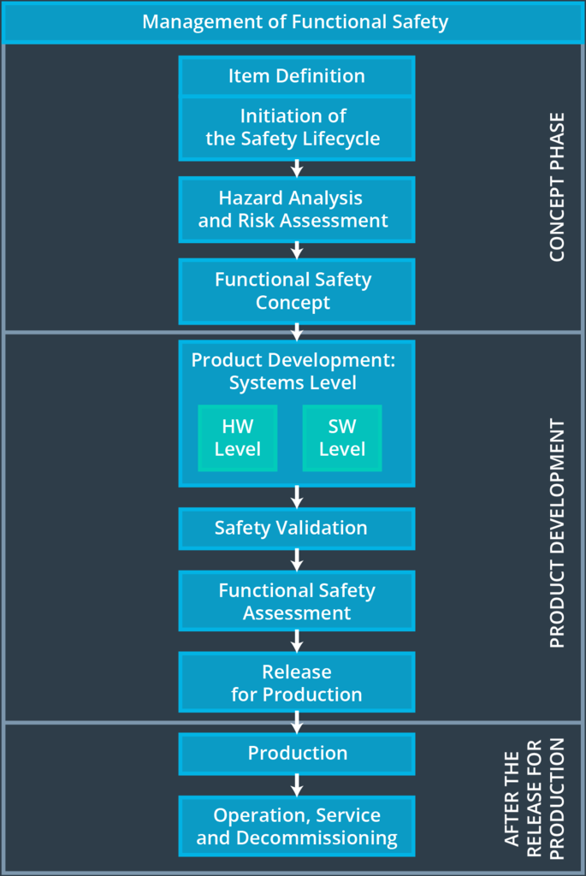
Flattened V Model
You can flatten out the V model to see it from a more linear perspective. The image gives the major steps involved in a functional safety project.

Slide 20
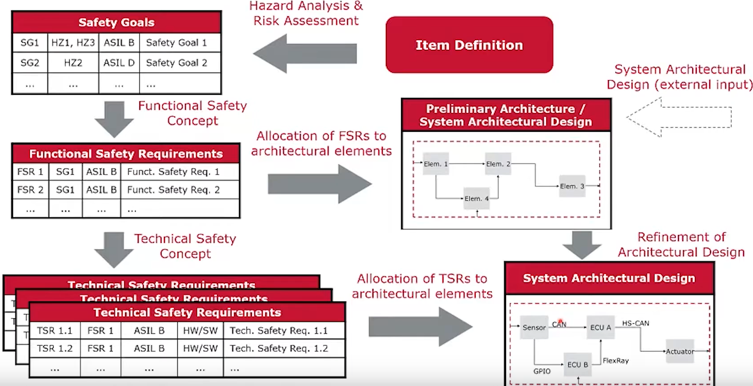
ISO 26262 Development Process
Vector webinar 2019 Functional Safety and SOTIF - Principles and Practice

Slide 21
Outline
Introduction to functional safety
Hazard Analysis and Risk Assessment (HARA)
Functional Safety Concept
Technical Safety Concept
Functional Safety for Hardware and Software
Notes:
Safety plan
The safety plan gives an overview of how you are going to achieve a safe system. A few of the major elements include:
what system is under consideration
the goal of the project
what steps will be taken to ensure safety
the roles and personnel involved in the project
the project timeline

Slide 22
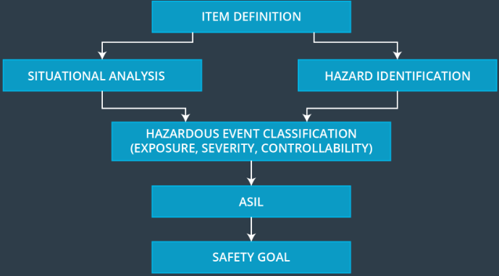
Hazard Analysis and Risk Assessment (HARA)
This is where we brainstorm to imagine hazards where the system malfunctions and causes injury or harm. Then the risk is calculated for each hazardous scenario.
Item Definition describes which vehicle system is under consideration. Followed by 5 steps:
Situational Analysis
Choose different driving scenarios like driving on a bumpy road, being towed, and driving on the freeway.
Hazard Identification
Figure out how the system could malfunction, e.g., an electronic parking brake failure.
Hazardous Event Classification According to Exposure, Severity and Controllability
Combine situations and hazards together, i.e., take a malfunction and then think about the malfunction under different driving scenarios. Like if the electronic parking brake failed while the vehicle was parked on a steep hill.
Then calculate three metrics called exposure, severity and controllability, which will depend on the hazard, the driving scenario and what might happen when the hazard occurs under the scenario.
ASIL Determination
After you have calculated exposure, severity and controllability, you can now determine the ASIL based on a table.
Safety Goal
A safety goal is a type of engineering requirement for vehicle functional safety; for example, "The electronic parking brake system shall always be engaged when the vehicle is in park on a gradient that is greater than 10 degrees".
Notes:
Here is a description of the main parts of this lesson:
Item Definition
You will determine which vehicle system or systems are under consideration. The item definition describes which vehicle system is under consideration. Part of the definition includes the system boundaries clarifying what is inside versus outside the system.
Situational Analysis
In a situational analysis, you choose different driving scenarios like driving on a bumpy road, being towed, and driving on the freeway.
Hazard Identification
This is where you figure out what could go wrong with your system: in other words, how the system could malfunction. Remember that ISO 26262 only looks at electrical and electronic malfunctions. An electronic parking brake failure, for example, could be a potential malfunction.
Hazardous Event Classification According to Exposure, Severity and Controllability
You then combine situations and hazards together. Essentially, you take a malfunction and then think about the malfunction under different driving scenarios. Like if the electronic parking brake failed while the vehicle was parked on a steep hill.
You can then calculate three metrics called exposure, severity and controllability. The values for these three metrics will depend on the hazard, the driving scenario and what might happen when the hazard occurs under the scenario.
ASIL
After you have calculated exposure, severity and controllability, you can now determine the ASIL. There is a table to facilitate this calculation.
Safety Goal
Finally, you derive safety goals based on the hazard analysis and risk assessment. A safety goal is a type of engineering requirement specifically for vehicle functional safety; for example, "The electronic parking brake system shall always be engaged when the vehicle is in park on a gradient that is greater than 10 degrees".
Please note that HARA is subjective and different groups may define values differently based on their view of severity, occurrence, and exposure. This may result from geographical or cultural factors. For example in countries where the vast majority of automobile use is in well lit, urban, area, with low speed limits, headlights may not be considered safety critical.
下一项

Slide 23
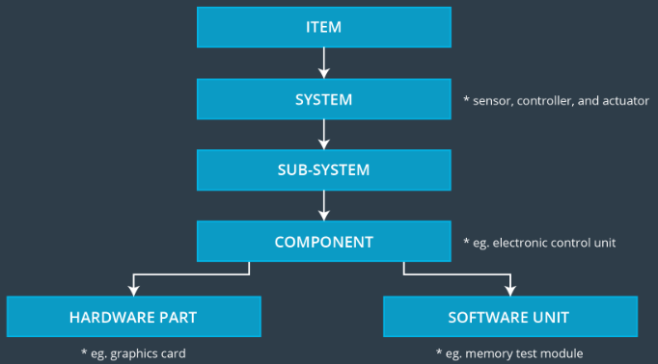
ISO 26262 Definition of System Hierarchy
An Item is a high-level system in the vehicle
A system is a set of elements that have at least a sensor, controller and an actuator.
The LAS has two sensors: a camera sensor and a driver steering torque sensor. The ECUs are the controllers, and the actuator is the motor that turns the steering wheel.
A sub-system is a smaller piece of a system.
A component may be an ECU (Electronic Control Unit), an embedded computer that contains the hardware and software for a specific vehicle functionality.
A component consists of hardware parts (CPU, GPU…) and software units (application program, memory test…)
Notes:
; in this case, the item is the lane assistance system. For clarity, throughout the lesson, you will see references to the "lane assistance item" rather than the "lane assistance system". The sensors, ECUs, and motor would all be considered elements. Element is a generic term for any part of a system. A system will generally have more than one element.
So an item can be thought of as a system made up of systems made up of systems …. etc.

Slide 24
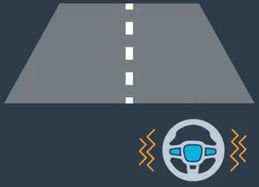
Running Example: Lane Assistance System (LAS)
A LAS has two functions:
Lane Departure Warning (LDW)
Lane Keeping Assistance (LKA)
If a driver departs a lane without using a turn signal, the system assumes that the driver has become distracted and did not mean to leave the lane. Two things will happen:
The LDW function will vibrate the steering wheel to provide a driver a haptic feedback.
The LKA function will move the steering wheel so that the wheels turn towards the center of the lane in order to stay in ego lane.
You can assume that the engineering requirement came from a product engineering team, and the safety engineer’s job will be to add extra requirements to ensure functional safety.
Notes:
The Lane Assistance System will have two functions:
Lane departure warning
Lane keeping assistance
If a driver departs a lane without using a turn signal, the system assumes that the driver has become distracted and did not mean to leave the lane. The system will vibrate the steering (LDW) and also move the steering wheel back towards the lane center (LKA).
When the driver drifts towards the edge of the lane, two things will happen:
the lane departure warning function will vibrate the steering wheel
the lane keeping assistance function will move the steering wheel so that the wheels turn towards the center of the lane
To state the lane departure warning engineering requirement more formally: "the lane departure warning function shall apply an oscillating steering torque to provide the driver a haptic feedback." In other words, the vehicle quickly moves the steering wheel back and forth to create a vibration. You can assume that the engineering requirement came from a product engineering team, and your job will be to add extra requirements to ensure functional safety.
Formal requirements specification:
LDW: "the lane departure warning function shall apply an oscillating steering torque to provide the driver a haptic feedback." In other words, the vehicle quickly moves the steering wheel back and forth to create a vibration. You can assume that the engineering requirement came from a product engineering team, and your job will be to add extra requirements to ensure functional safety.
The lane keeping assistance functionality will automatically assist the driver; the steering wheel turns towards the center of the lane. We will formally list the requirement as "the lane keeping assistance function shall apply the steering torque when active in order to stay in ego lane". Ego lane refers to the lane in which the vehicle currently drives.

Slide 25
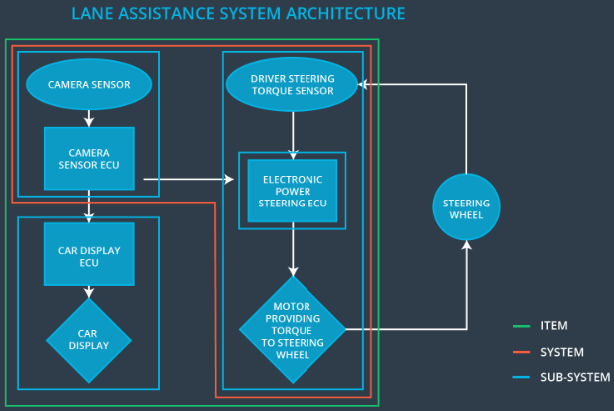
LAS Architecture
LAS consists of 1 item (green box), 1 system (red box), and 4 subsystems (blue boxes).
Subsystems may be nested (Electronic Power Steering ECU is a subsystem within a subsystem).
Notes:
The Electronic Power Steering ECU subsystem consists of 4 components; the LDW software component consists of 2 software units (processes)

Slide 26
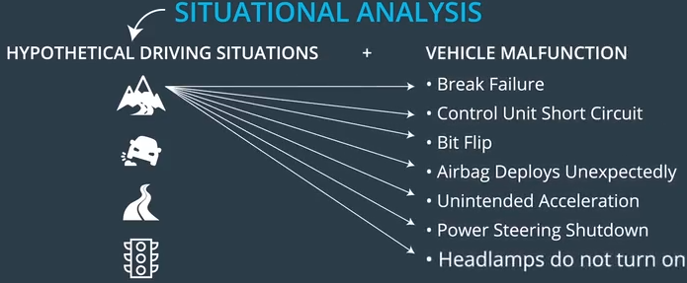
Situational Analysis
Brainstorming about hypothetical driving situations and analyze what would happen in case of vehicle malfunction.

Slide 27
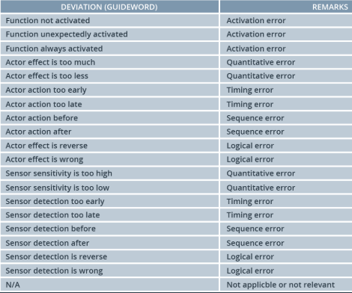
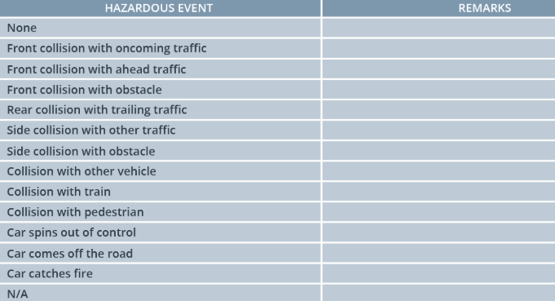
Predefined Guidewords
Use predefined guidewords to help unify terminology
Below shows guidewords for deviation (malfunction) and Hazardous Event
Example:
[Operational Mode] on [Operational Scenario] during [Environmental Details] with [Situational Details] and [Item Usage] system. Terms in brackets should be taken from standard guideword tables.
Ex1. [backward driving] on [city road] during [fog] with [low speed] and [correctly used] system.
Ex2 (LAS example): [Normal driving] on a [highway] during [rain (slippery road)] with [high speed] and [correctly used] system

Slide 28
Hazard Identification for LDW
Function | LDW function shall apply an oscillating steering torque to provide the driver haptic feedback.
Malfunction | Actor effect is too much.
Malfunction details | LDW function applies an oscillating torque with very high torque (above limit).
Hazardous event | Collision with other vehicle.
Event details | High haptic feedback can affect driver's ability to steer as intended. The driver could lose control of the vehicle and collide with another vehicle or with road infrastructure.
Summary description | The LDW function applies too high an oscillating torque to the steering wheel (above limit).

Slide 29
Hazard Identification for LKA
Function | LKA function will move the steering wheel so that the wheels turn towards the center of the lane.
Malfunction | Driver takes both hands off the wheel.
Malfunction details | Driver misuses the function by taking both hands off the wheel and incorrectly treating the car as an AV, causing LKA function to be always activated
Hazardous event | Collision with other vehicle.
Event details | …
Summary description | …

Slide 30
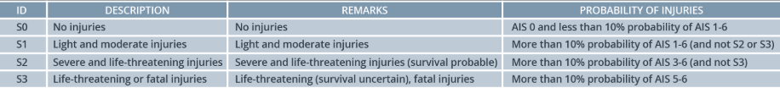
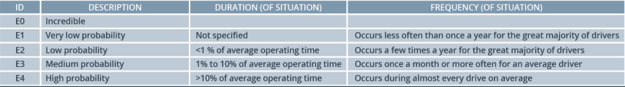
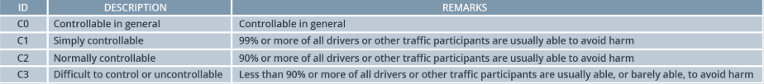
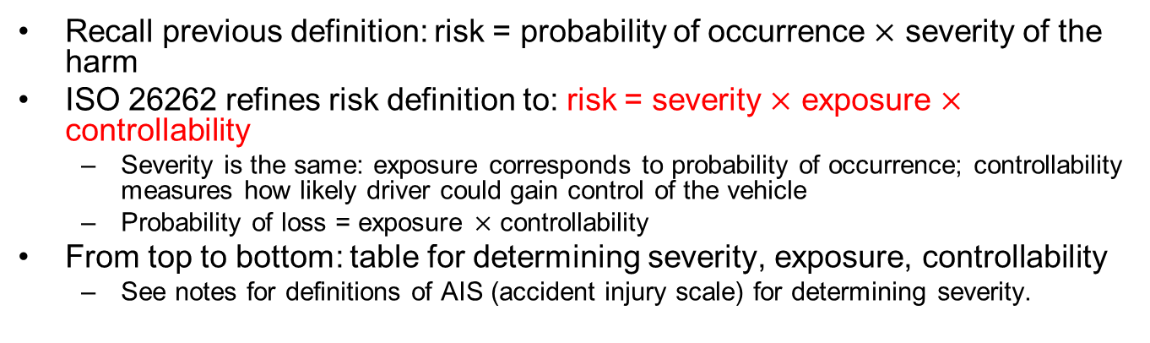
ISO 26262 Risk Measurement
Recall previous definition: risk = probability of occurrence $×$ severity of the harm
ISO 26262 refines risk definition to: risk = severity $×$ exposure $×$ controllability
Severity is the same: exposure corresponds to probability of occurrence; controllability measures how likely driver could gain control of the vehicle
Probability of loss = exposure $×$ controllability
From top to bottom: table for determining severity, exposure, controllability
See notes for definitions of AIS (accident injury scale) for determining severity.
Notes:
The accident injury scale is published by the Association for the Advancement of Automotive Medicine (AAAM) and contains seven levels: AIS 0 through AIS 6. Here are examples of the injuries associated with each level.
AIS 0: no injuries
AIS 1: light injuries such as skin-deep wounds, muscle pains, whiplash
AIS 2: moderate injuries such as deep flesh wounds
AIS 3: severe but not life-threatening injuries such as skull fractures without brain injury
AIS 4: severe injuries that are life-threatening but with probable survivability such as concussion with or without skull fractures with up to 12 hours of unconsciousness
AIS 5: critical injuries (life-threatening, survival uncertain) such as spinal fractures below the fourth cervical vertebra with damage to the spinal cord
AIS 6: extremely critical or fatal injuries such as fractures of the cervical vertebrae above the third cervical vertebra with damage to the spinal cord
Note that AIS is provided in the standard as an example. There is no requirement to use AIS and the "Probability of Injuries" field is a suggested guideline, not a strict requirement.

Slide 31
LAS Example
Situation: [Normal driving] on a [highway] during [rain (slippery road)] with [high speed] and [correctly used] system.
Severity: S3 (life-threatening or fatal injuries)
Highway driving implies high severity of harm.
Exposure: E3 (medium probability)
The situation is not uncommon, but also not everyday.
Controllability: C3 (difficult to control or uncontrollable)
Drive may lose control if the steering wheel vibration is excessive.

Slide 32
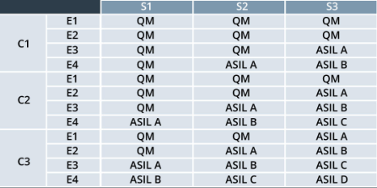
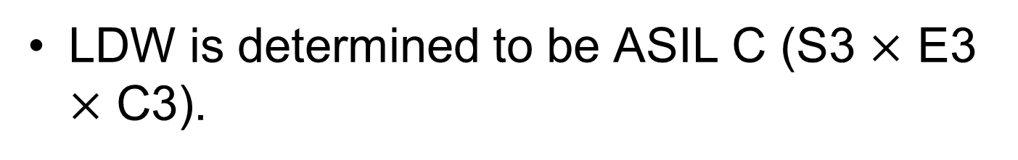
ASIL Determination
LDW is determined to be ASIL C (S3 $×$ E3 $×$ C3).

Slide 33
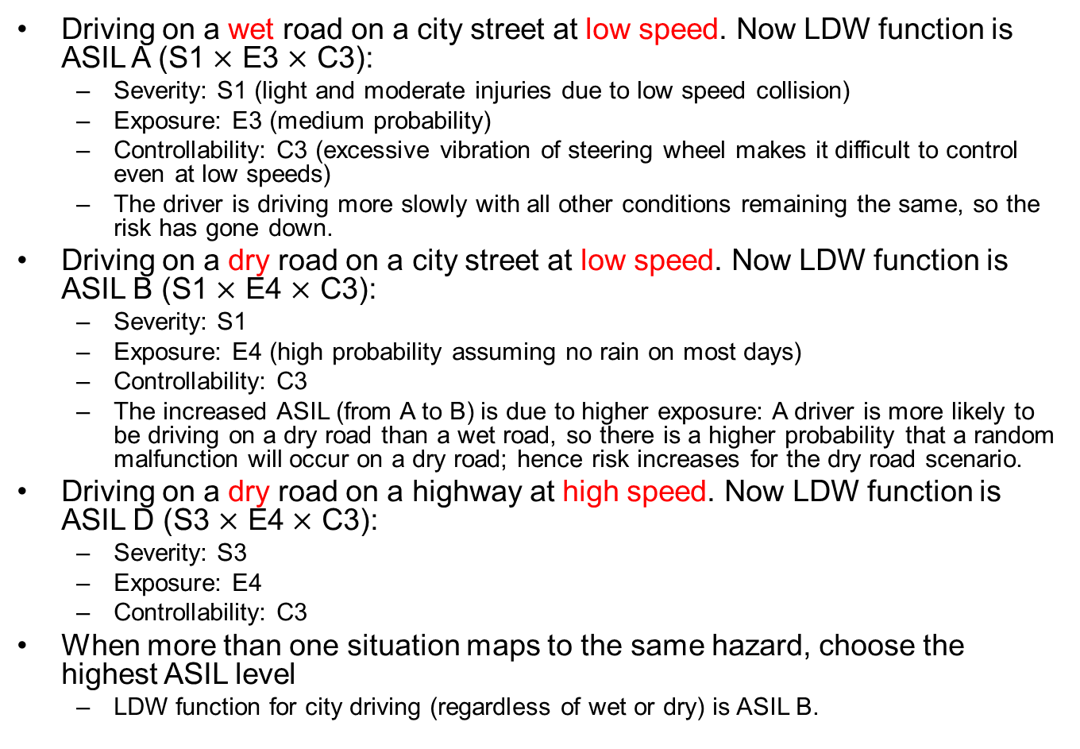
LDW in Other Driving Situations
Driving on a wet road on a city street at low speed. Now LDW function is ASIL A (S1 $×$ E3 $×$ C3):
Severity: S1 (light and moderate injuries due to low speed collision)
Exposure: E3 (medium probability)
Controllability: C3 (excessive vibration of steering wheel makes it difficult to control even at low speeds)
The driver is driving more slowly with all other conditions remaining the same, so the risk has gone down.
Driving on a dry road on a city street at low speed. Now LDW function is ASIL B (S1 $×$ E4 $×$ C3):
Severity: S1
Exposure: E4 (high probability assuming no rain on most days)
Controllability: C3
The increased ASIL (from A to B) is due to higher exposure: A driver is more likely to be driving on a dry road than a wet road, so there is a higher probability that a random malfunction will occur on a dry road; hence risk increases for the dry road scenario.
Driving on a dry road on a highway at high speed. Now LDW function is ASIL D (S3 $×$ E4 $×$ C3):
Severity: S3
Exposure: E4
Controllability: C3
When more than one situation maps to the same hazard, choose the highest ASIL level
LDW function for city driving (regardless of wet or dry) is ASIL B.
Notes:
Examples of How Driving Situations Affect ASIL
To reinforce how severity, exposure, and controllability relate to ASIL, let's look at the lane departure warning example one more time. In the original situational analysis, we said that the vehicle was driving on the highway in the rain at high speed, which led to ASIL C.
What about driving on a wet road on a city street at low speed? A low speed collision implies severity of S1. Exposure remains E3 because of the wet road. Controllability would could still remain C3 because the steering wheel jerking back and forth violently would be difficult to control even at lower speeds. S1, E3 and C3 result in ASIL A. The ASIL went down to A whereas originally we had ASIL C. Intuitively, this makes sense; the driver is driving more slowly with all other conditions remaining the same, so the risk has gone down.
What about driving on a dry road on a city street at low speed? Severity would stay at S1. Exposure now increases to E4 and controllability remains at C3. ASIL now increases to B. Perhaps counterintuitively, if we consider driving on a dry road instead of a wet road, risk increases. The increased risk comes from the exposure. A driver is more likely to be driving on a dry road than a wet road, so there is a higher probability that a random malfunction will occur on a dry road; hence risk increases for the dry road scenario.
What if we had considered high speed highway driving on a dry road? Exposure would go up to E4, severity would be S3, and controllability C3. The ASIL would then increase to ASIL D.
When more than one situation maps to the same hazard, you will be conservative and choose the highest ASIL level for the hazard. If we were considering the possibility that the lane departure warning system vibrates too much on wet highways and also dry highways, we would assign ASIL D.

Slide 34

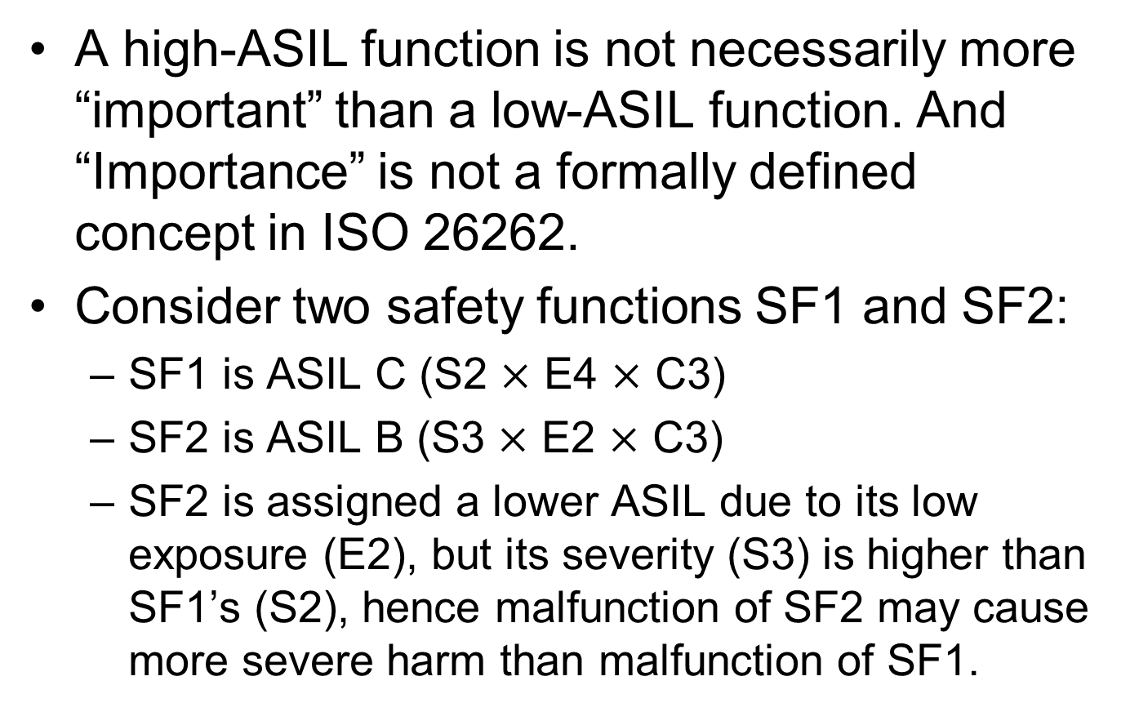
ASIL $≠$ Importance
A high-ASIL function is not necessarily more “important” than a low-ASIL function. And “Importance” is not a formally defined concept in ISO 26262.
Consider two safety functions SF1 and SF2:
SF1 is ASIL C (S2 $×$ E4 $×$ C3)
SF2 is ASIL B (S3 $×$ E2 $×$ C3)
SF2 is assigned a lower ASIL due to its low exposure (E2), but its severity (S3) is higher than SF1’s (S2), hence malfunction of SF2 may cause more severe harm than malfunction of SF1.
Notes:
If SF1 fails, the driver is still able to control the vehicle, hence controllability is C2.
If SF2 fails, the driver is not able to control it, hence controllability is C3.

Slide 35
Analysis and Testing for Different ASILs
Higher ASIL levels require more analysis and testing to reduce risk to acceptable levels. A few examples of extra measures that need to be taken for higher ASILs:
Fault Tree Analysis (FTA) is mandatory for ASIL C and ASIL D.
ASIL D requires hardware failure rate of <10 FIT; ASIL B/C require hardware failure rate of <100 FIT; ASIL A requires hardware failure rate of <1000 FIT.
The FIT rate of a component is the number of failures expected in one billion hours of operation.
Software units with ASIL D require more rigorous testing like MC/DC coverage whereas ASIL B only mandates DC coverage.
Notes:
(FTA and software testing are not covered in this course.)
ASIL
Random hardware failure target values
D
$<{10}^{−8}$ per hour
C
$<{10}^{−7}$ per hour
B
$<{10}^{−7}$ per hour
A
$<{10}^{−6}$ per hour

Slide 36
Safety Goal for LDW
For the hazardous event:
“LDW function applies too high an oscillating torque to the steering wheel.”
Safety goal:
“The oscillating torque from the LDW function shall be limited.”
Notes:
It is ASIL C.

Slide 37
Quiz: Safety Goal for LKA
What is the safety goal for LKA function?
1. It shall provide a low enough torque to the steering wheel such that the driver cannot feel the system working.
2. It shall provide torque to the steering wheel such that the vehicle moves away from the center of the lane.
3. It shall only turn on when it is raining.
4. It shall be time-limited and the additional steering torque shall end after a given time interval so that the driver cannot misuse the system for AD
ANS: 4
Notes:
This can be prevented by adding extra steering torque for a limited amount of time and then stop providing extra torque.

Slide 38
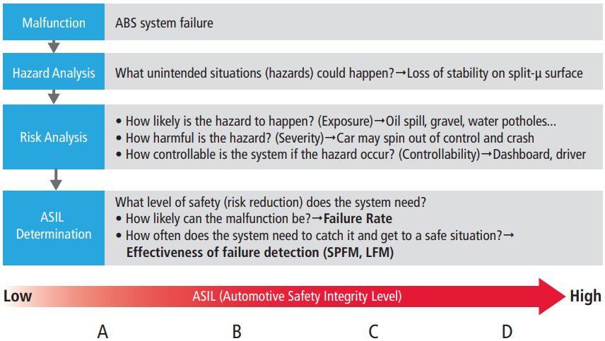
HARA Summary
Single-Point Fault Metric (SPFM) ; Latent Fault Metric (LFM)
https://www.cadence.com/content/dam/cadence-www/global/en_US/documents/solutions/automotive-functional-safety-wp.pdf
Notes:
Five steps
Conduct a situational analysis
Identify malfunctions
Combine situations and malfunctions and assess risk
Determine ASILs
Derive safety goals– Probabilistic metrics for hardware failures (PMHF)

Slide 39
Outline
Introduction to functional safety
Hazard Analysis and Risk Assessment (HARA)
Functional Safety Concept
Technical Safety Concept
Functional Safety for Hardware and Software
Notes:
Safety plan
The safety plan gives an overview of how you are going to achieve a safe system. A few of the major elements include:
what system is under consideration
the goal of the project
what steps will be taken to ensure safety
the roles and personnel involved in the project
the project timeline

Slide 40
Functional Safety Concept
In functional safety, "concept" is synonymous with "document".
It includes the following steps:
Derive functional safety requirements.
Refine the item architecture.
Allocate functional safety requirements to the item architecture
Determine ASILs for the subsystems
Notes:
The functional safety concept provides a high level overview of the system. Based on the hazard analysis and risk assessment, you figure out what your system is required to do to stay safe. Then you identify what part of your system will need to be adjusted to take into account the new functionality.

Slide 41
Malfunctions
Based on information from HARA, we identify 2 malfunctions for LDW function:
“The LDW function applies an oscillating torque with very high torque amplitude (above limit).”
“The LDW function applies an oscillating torque with very high torque frequency (above limit).”
And 1 malfunction for LKA function:
“The LKA function is not limited in time duration which leads to misuse as an AD function.”

Slide 42
Formal Safety Analysis Methods
There are formal methods for:
Deriving safety requirements
Identifying conditions and causes that could lead to requirement violations
Identifying other hazards not identified in the Hazard Analysis and Risk Assessment
They include (not covered in this course):
Failure Modes and Effects Analysis (FMEA)
Hazard and Operability Study (HAZOPS)
Failure Modes Effects and Diagnostic Analysis (FMEDA)
Fault Tree Analysis (FTA)
Reliability Block Diagram
…
But we will just use some basic logic to derive functional safety requirements from the safety goals.
Notes:
ETA

Slide 43
Functional Safety Requirements
Based on the 2 safety goals from HARA:
1. “The oscillating steering torque from the LDW function shall be limited.”
2. “The LKA function shall be time limited, and the additional steering torque shall end after a given time interval so that the driver cannot misuse the system for AD.”
We derive functional safety requirements from safety goal 1 of the LDW function:
1. “The lane assistance item shall ensure that the lane departure oscillating torque amplitude is below Max_Torque_Amplitude.”
2. “The lane assistance item shall ensure that the lane departure oscillating torque frequency is below Max_Torque_Frequency.”
And from safety goal 2 of the LKA function:
3. “The lane assistance item shall ensure that the lane keeping assistance torque is applied for only Max_Duration”.
Notes:
So in the case of the lane departure warning, "MORE" seems like an appropriate guide word; the lane departure warning is giving MORE torque than what is safe. There would be two malfunctions. The oscillating amplitude is too high and the oscillating frequency is too high. Formally, the malfunctions would be:
"The lane departure warning function applies an oscillating torque with very high torque amplitude (above limit)"
"The lane departure warning function applies an oscillating torque with very high torque frequency (above limit)"
For the lane keeping assistance function, "NO" would be an appropriate guide word. The lane keeping assistance keeps the vehicle centered in the lane. The malfunction would be that the assistance has no time limit. The malfunction would be:
"The lane keeping assistance function is not limited in time duration which leads to misuse as an autonomous driving function."
For the lane keeping assistance function, the malfunction was that there was no time limit, and the driver could treat the system as if it were designed for autonomous driving. We determined a safety goal saying the "lane keeping assistance function shall be time limited and the additional steering torque shall end after a given timer interval so that the driver can not misuse the system for autonomous driving". In other words, the lane assistance system should stop applying extra torque after a certain amount of time.
Zgu: Video says lane keeping, but I think it should be lane assistance

Slide 44
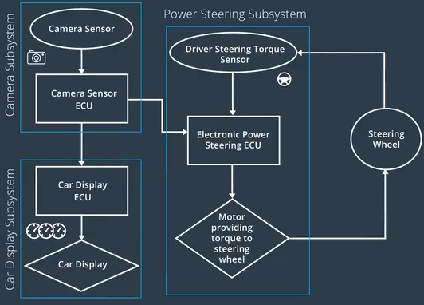
Allocating Requirements to Architecture
We need to allocate these requirements to subsystems. If we allocate them to the Electronic Power Steering ECU, the requirements become:
1. “The Electronic Power Steering ECU shall ensure that the lane departure oscillating torque amplitude is below Max_Torque_Amplitude.”
2. “The Electronic Power Steering ECU shall ensure that the lane departure oscillating torque frequency is below Max_Torque_Frequency.”
3. “The Electronic Power Steering ECU shall ensure that the lane keeping assistance torque is applied for only Max_Duration.”
Notes:
We derive additional functional safety requirements:
From safety goal of LDW (#1):
The lane departure oscillating torque amplitude is below Max_Torque_Amplitude.
The lane departure oscillating torque frequency is below Max_Torque_Frequency.
From safety goal of LKA (#2):
The electronic power steering ECU shall ensure that the lane keeping assistance torque is applied for only Max_Duration.

Slide 45
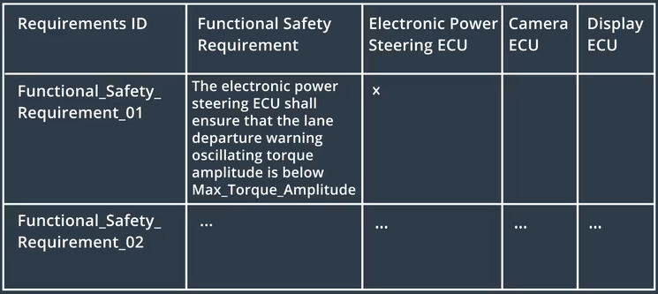
Requirements to Architecture Allocation Table

Slide 46
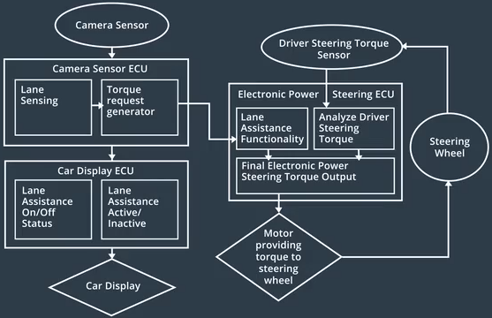
Architectural Refinement
To implement the requirements, we add software blocks to the 3 ECUs (Electronic Power Steering, Camera Sensor, Car Display).
Requirements may also be implemented with mechanical components instead of software blocks
Notes:
Not all requirements, however, need software blocks. For example, requirements can also be solved with mechanical systems

Slide 47
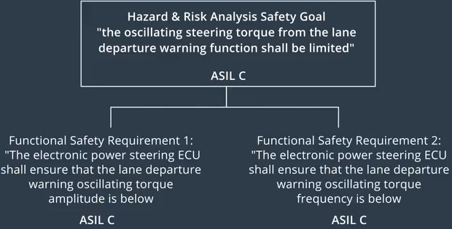
ASIL Inheritance
The 2 functional safety requirements inherit ASIL C from the safety goal.

Slide 48
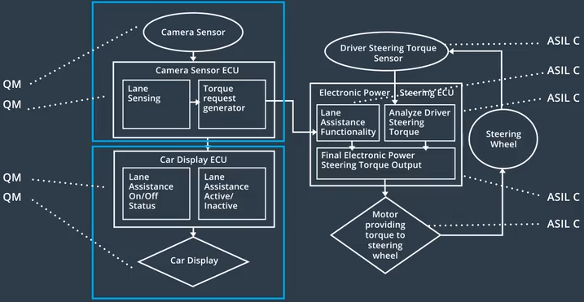
Allocation of ASIL
The entire Power-Steering subsystem (ECU, sensor and motor) inherits ASIL-C from the 2 functional safety requirements.
Since no functional safety requirements are allocated to the Camera Sensor and Car Display subsystems, they are not relevant to functional safety analysis, and are assigned QM (Quality Management).

Slide 49
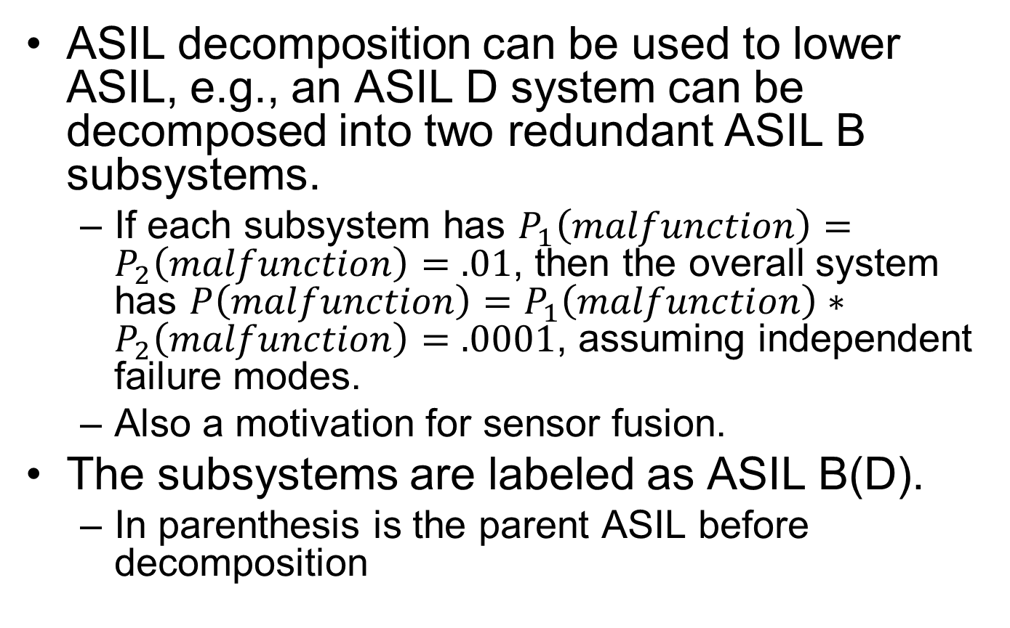
ASIL Decomposition
ASIL decomposition can be used to lower ASIL, e.g., an ASIL D system can be decomposed into two redundant ASIL B subsystems.
If each subsystem has $P_{1}\left(malfunction\right)=P_{2}\left(malfunction\right)=.01$, then the overall system has $P\left(malfunction\right)=P_{1}\left(malfunction\right)∗P_{2}\left(malfunction\right)=.0001$, assuming independent failure modes.
Also a motivation for sensor fusion.
The subsystems are labeled as ASIL B(D).
In parenthesis is the parent ASIL before decomposition
Notes:
Redundant subsystems lower risk.

Slide 50
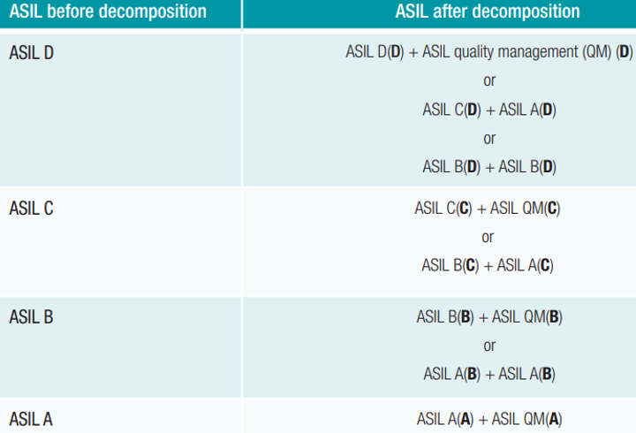
ISO 26262 ASIL Decomposition Rules

Slide 51
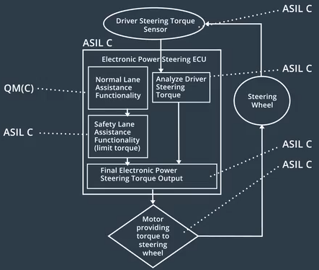
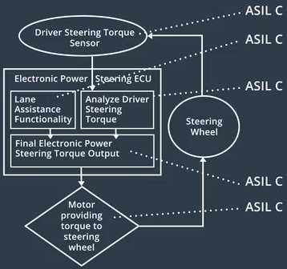
ASIL Decomposition for Our Example
We decompose the software block Lane Assistance Functionality (ASIL C) into 2 software blocks:
QM(C): Normal Lane Assistance Functionality
ASIL C(C): Safety Lane Assistance Functionality (limit torque)
Since the Safety Lane Assistance Functionality is much smaller and simpler than the Normal Lane Assistance Functionality, this decomposition significantly reduces the burden of system design and analysis at ASIL C level.
51

Slide 52
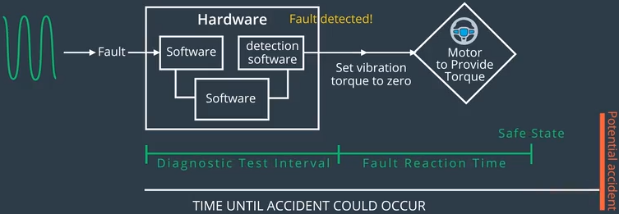
Fault-Tolerance Time Interval (FTTI)
FTTI for a functional safety requirement refers to the time it takes to detect and react to a malfunction.
For example, for functional safety requirement 1:
The Electronic Power Steering ECU shall ensure that the lane departure oscillating torque amplitude is below Max_Torque_Amplitude.
Fault: vibration (oscillating) torque amplitude exceeds the given threshold
The safe state with acceptable risk level will be reached after FTTI, which is equal to sum of:
Diagnostic Test Interval: amount of time needed to detect the fault.
Fault Reaction Time: amount of time needed to react, e.g., by setting the vibration torque to zero.
The FTTI must not exceed the time until accident could occur, say 50 ms.
Notes:
. We can impose an upper bound on FTTI based on vehicle speed, road conditions, etc.,

Slide 53
Warning and Degradation Concept
It discusses:
how the driver will be warned of a malfunction.
what the system will do to "degrade" the functionality i.e. take the system to a safe state and recover from a safe state.
Gradual Degradation vs. Turning a System Off
LDW and LKA are not critical for driving a vehicle. So if the system has a malfunction, we can turn them off to take the system to a safe state.
Turning off the system is not the only option. Some systems can provide limited functionality and "degrade" to different levels depending how bad the malfunction is. A car engine control system is one example. If one sensor fails, the engine control system might reduce the torque output of the motor so that the vehicle can still be driven but at a lower speed. Degrading the engine control system to a safer, but functioning, state would help the driver avoid getting stranded.
Notes:
A document explaining driver warnings and how the system will be taken to a safe state.
How the driver will be alerted when the system has reduced functionality or is turned off completely.
How the vehicle will transition to and recover from the safe state.
on the other hand, a functioning motor is necessary for driving a vehicle.

Slide 54
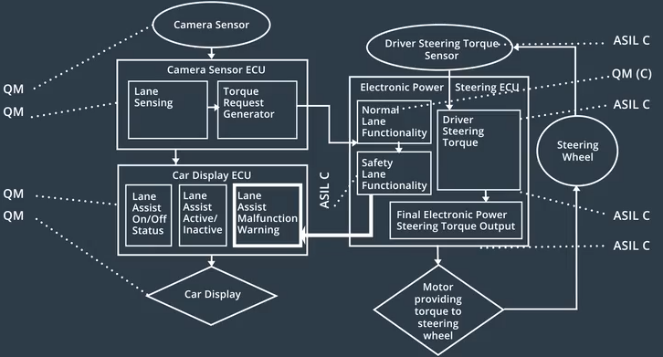

Driver Warning
In case of malfunction of functional safety requirement (1 or 2), turn on the warning light to the driver.
This is implemented by adding a software block Lane Assist Malfunction Warning, and a connection from Safety Lane Functionality to it.

Slide 55
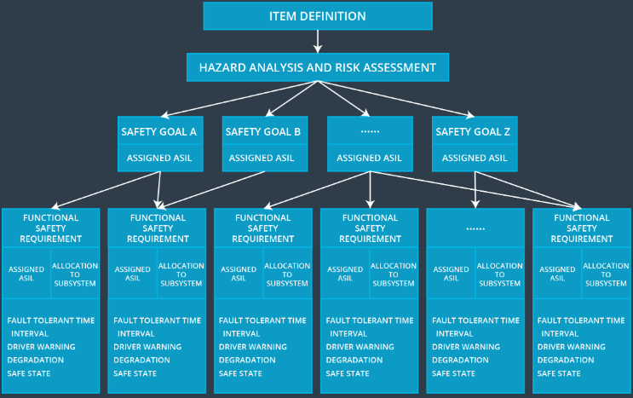
Functional Safety Analysis Workflow

Slide 56
Outline
Introduction to functional safety
Hazard Analysis and Risk Assessment (HARA)
Functional Safety Concept
Technical Safety Concept
Functional Safety for Hardware and Software
Notes:
Safety plan
The safety plan gives an overview of how you are going to achieve a safe system. A few of the major elements include:
what system is under consideration
the goal of the project
what steps will be taken to ensure safety
the roles and personnel involved in the project
the project timeline

Slide 57
Technical Safety Concept
The functional safety concept is the last step in the concept phase
The product development phase is divided into two parts:
Product development at the system level (here lies technical safety concept)
Product development at the hardware and software level
Notes:
The product development phase also includes designing hardware and software, discussed in the next lesson.
The technical safety concept refers to product development at the system level.
While the functional safety concept gives a high level overview of the system and what it needs to do, the technical safety concept gets into more detail.

Slide 58
Technical Safety Concept
The technical safety concept involves 2 steps:
Turning functional safety requirements into technical safety requirements for each of these subsystems (Camera, Display, Power Steering).
Allocating technical safety requirements to the system architecture.
Notes:
This will set us up for drilling down into software and hardware implementatio
Before developing hardware or software, the technical safety requirements need to be determined for each of these subsystems, based on functional safety requirements for the lane keeping item.
The item has 3 subsystems:
Camera subsystem
Display subsystem
Power Steering system

Slide 59
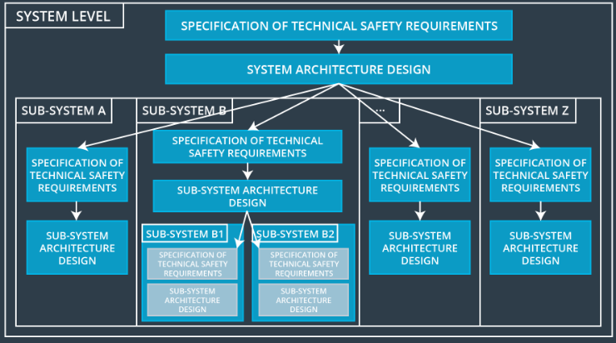
Technical Safety Concept at the System Level vs. ECU Level
In our simple example, the only safety relevant element was the Electronic Power Steering ECU; thus, our technical safety concept will go directly to the ECU level. But in general, you will need to develop multiple technical safety concepts; one for each safety-relevant subsystem, and then one for each safety-relevant ECU.
Figure shows how a technical safety concept might be divided into several documents for different subsystems.
Notes:
put most of the safety-relevant functionality in the power steering ECU.
In the ADAS lane assistance example, we have said that the only safety-relevant subsystem is the electronic power steering. And our example has put most of the safety-relevant functionality in the power steering ECU.
This is a simplified example. Most of the time, multiple subsystems will be involved in a technical safety analysis. When there are multiple subsystems, the technical safety concept might have to be divided into more than one document.
One technical safety concept will be called the "Technical Safety Concept at the System Level". This document would look at how the subsystems interact with each other.
There might be a separate technical safety concept that drills down to the ECU level. Each safety relevant ECU would have its own technical safety concept document.
In our simplified lane assistance example, the only safety relevant element was the electronic power steering ECU; thus, our technical safety concept will go directly to the ECU level. But in general, you will need to develop multiple technical safety concepts; one at the system level and then one for each safety relevant ECU.
Here is an diagram showing how a technical safety concept might be divided into several documents:

Slide 60
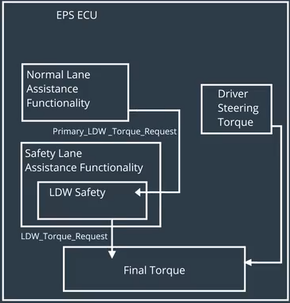
Functional vs. Technical Safety Requirements
Functional safety requirement is abstract and high-level:
“The lane keeping item shall ensure that the lane departure oscillating torque amplitude is below Max_Torque_Amplitude.”
Technical safety requirement is more concrete, and describes the signal flow, and which component is in charge of the functionality:
“The LDW safety component shall ensure that the amplitude of the ‘LDW_Torque_Request’ sent to the ‘Final torque’ component is below ‘Max_Torque_Amplitude’.”
This can be implemented by setting ‘LDW_Torque_Request’ to 0 if it exceeds ‘Max_Torque_Amplitude’, but we are not concerned with implementation yet.
Notes:
Missing signal flow arrows The Electronic Power Steering ECU shall ensure that the lane departure oscillating torque amplitude is below Max_Torque_Amplitude.” It is more concrete and gets into the details of the item's technology.

Slide 61
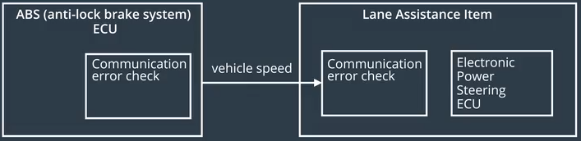
Additional Categories of Technical Safety Requirements
1. Detecting faults within a system
“The validity and integrity of the data transmission for ‘LDW_Torque_Request’ signal shall be ensured.”
2. Detecting faults in an external device interacting with the system
The Anti-Lock Brake ECU might send vehicle speed data to the Electronic Power Steering ECU. CRCs (Cyclic Redundancy checks) or alive counters can be used to detect fault in data transmission.
Notes:
ISO 26262 Definition of Latent Faults
A more rigorous definition of latent faults from ISO 26262 reads:
multiple-point fault (3.96) whose presence is not detected by a safety mechanism (3.141) nor perceived by the driver within the multiple-point fault detection time interval (3.97)
Faults External to the Lane Keeping Item
We mentioned that a possible technical safety requirement for an external fault could be for code that checks communication errors between the anti-lock brake ECU and the power steering ECU. The anti-lock brake ECU might share vehicle speed data with the power steering ECU. We are not going to expand on this example in the rest of the lesson. But if you want to challenge yourself, consider expanding on this idea in the final project.
Imagine that the lane keeping assistance function does not take driver speed into account when deciding how much torque to apply. This could lead to a potentially hazardous situation where the system turns the wheel too abruptly at a high vehicle speed. Or the lane keeping assistance provides too much extra torque on a sharp curve. The driver could lose control of the vehicle. So this idea could be part of a hazard and risk analysis, which would lead to a safety goal. Then you'd derive functional safety requirements from the safety goal. And finally you'd derive technical safety requirements from the functional safety requirements.
More Technical Safety Requirements
Soon it will be your turn to identify technical safety requirements! In the project, you will be responsible for deriving technical safety requirements for the other two functional safety requirements.
The other two functional safety requirements were:
"the electronic power steering ECU shall ensure that the lane departure warning oscillating torque frequency is below Max_Torque_Frequency".
"the lane keeping assistance function shall be time limited and the additional steering torque shall end after a given timer interval so that the driver can not misuse the system for autonomous driving".
You will use the examples we've already given as a guide for deriving technical safety requirements. The truth is, most of the technical safety requirements already derived would also be relevant to the two other functional safety requirements. You might have to change variable names or architectural element names.
Remember that some technical safety requirements can be derived directly from a functional safety requirement; other technical safety requirements will fall under the five categories described in the above video.
Methods for Checking Data Validity and Integrity
One of the technical safety requirements mentioned checking the data validity and integrity of the data transmission: "The validity and integrity of the data transmission for LDW_Torque_Request signal shall be ensured."
To check data validity and integrity, you can add a CRC (cyclic redundancy check); a CRC is a well established methods that looks for changes to raw data. A qualifier can then be added as well, which is a signal indicating whether or not a signal is valid. The CRC ensures the data that is sent out by one element is the same data received by another element.
Another common mechanism is an alive counter. An alive counter checks that the signal is new and not an old signal; an alive counter increases the count every time a signal goes out.
CRCs and alive counters can be used together to guarantee correct transmission. The final lesson on software requirements will also discuss a specific CRC protocol in more depth.
Not covered here, but you may try it at home (I know you won’t):
If the lane keeping assistance function does not take driver speed into account when deciding how much torque to apply, this could lead to a potentially hazardous situation where the system turns the wheel too abruptly at a high vehicle speed, or it provides too much extra torque on a sharp curve. The driver could lose control of the vehicle. So this idea could be part of a hazard and risk analysis, which would lead to a safety goal. Then you'd derive functional safety requirements from the safety goal. And finally you'd derive technical safety requirements from the functional safety requirements.

Slide 62
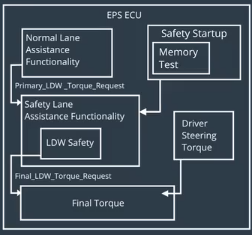
Additional Categories of Technical Safety Requirements
3. Reaching a safe state
“As soon as a failure is detected by the LDW function, it shall deactivate the LDW feature and the ‘LDW_Torque_Request’ shall be set to zero.”
4. Implementing a warning and degradation concept
“As soon as the LDW function deactivates the LDW feature, the ‘LDW Safety’ software block shall send a signal to the car display ECU to turn on a warning light.”
5. Preventing latent faults
“Memory test shall be conducted at start up of the EPS ECU to check for any faults in memory.”

Slide 63
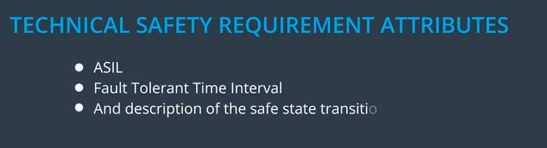
Technical Safety Requirement Examples
Technical safety requirement inherits ASIL from its corresponding functional safety requirement.
TechSafReq01 to 04 are all based on the functional safety requirement “The lane keeping item shall ensure that the lane departure oscillating torque amplitude is below Max_Torque_Amplitude.” with ASIL C, hence they are all ASIL C.
TechSafReq05 is ASIL A, since ISO 26262 says that “latent fault detection for ASIL C requirement can be labeled ASIL A.”
Req ID | Technical Safety Requirement. | FTTI | ASIL
TechSafReq01 | The LDW safety component shall ensure that the amplitude of the 'LDW_Torque_Request' sent to the 'Final electronic power steering Torque' component is below 'Max_Torque_Amplitude. | 50 ms | C
TechSafReq02 | As soon as the LDW function deactivates the LDW feature, the 'LDW Safety' software block shall send a signal to the car display ECU to turn on a warning light. | 50 ms | C
TechSafReq03 | As soon as a failure is detected by the LDW function, it shall deactivate the LDW feature and the 'LDW_Torque_Request' shall be set to zero. | 50 ms | C
TechSafReq04 | The validity and integrity of the data transmission for 'LDW_Torque_Request' signal shall be ensured. | 50 ms | C
TechSafReq05 | Memory test shall be conducted at start up of the EPS ECU to check for any faults in memory. | ignition cycle | A

Slide 64
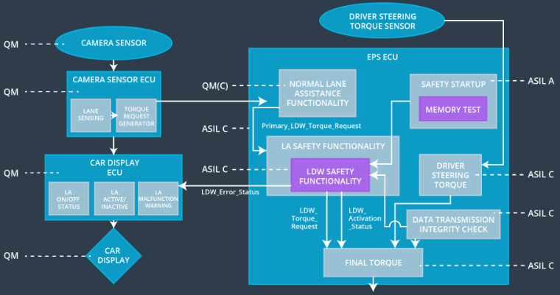
Allocation of Requirements to System Architecture
TechSafReq01 to 05 have been allocated to different software elements such as the "LDW Safety Functionality" block, the "Data Transmission Integrity Check", or other relevant blocks inside the EPS ECU.
Notes:
the technical safety requirements will be allocated to different software elements such as the "LDW Safety Functionality" block, the "Data Transmission Integrity Check", or other relevant blocks inside the EPS ECU.

Slide 65
Allocation of Requirements to System Architecture: Notable Points
Elements inherit the highest ASIL from the technical safety requirements. So if the same software element provides functionality to the LDW function (ASIL C) and LKA function (ASIL B), the higher ASIL wins (ASIL C).
If an element contains subelements with different ASILs, both sub-elements receive the highest ASIL. The exception is if the criteria for coexistence is met:
If a failure in one sub-element will not affect the other sub-element, then the sub-elements can have different ASILs.
Internal and external interfaces for safety-related elements need to be clearly defined. This way non-safety related elements are clearly identified as well.
Notes:
If a subelement has an ASIL but another subelement is QM, then the same rule applies and both will take the highest ASIL.

Slide 66
Outline
Introduction to functional safety
Hazard Analysis and Risk Assessment (HARA)
Functional Safety Concept
Technical Safety Concept
Functional Safety for Hardware and Software
Notes:
Safety plan
The safety plan gives an overview of how you are going to achieve a safe system. A few of the major elements include:
what system is under consideration
the goal of the project
what steps will be taken to ensure safety
the roles and personnel involved in the project
the project timeline

Slide 67
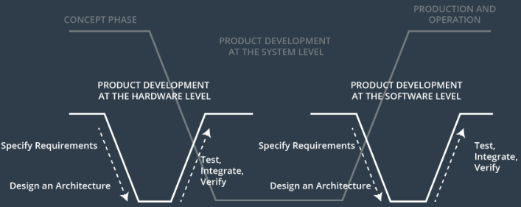
Functional Safety for Hardware and Software
After so much requirements engineering, finally we are ready to develop some hardware and software!
67

Slide 68
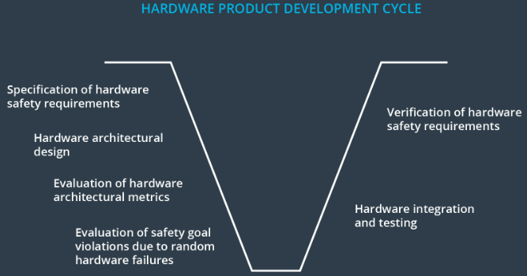
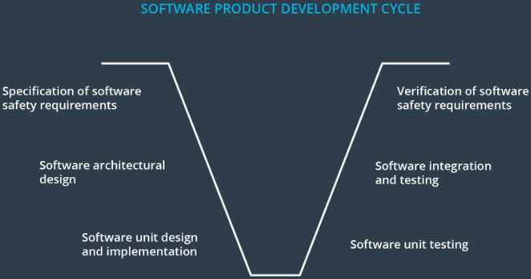
Hardware and Software Product Development Life-Cycle
The general idea represented in each V stays the same; first, you specify safety requirements. Then you allocate these requirements to a system architecture. Finally you test, integrate, and verify.
But there is an extra step on the hardware and software sides.
For hardware, the V model includes sections about hardware architectural metrics and evaluation of random hardware failures.
For software, there is an architectural design section as well as a unit design section.
A unit is a smaller part of a software architecture, e.g., could be a software driver to read raw data from a camera sensor.

Slide 69
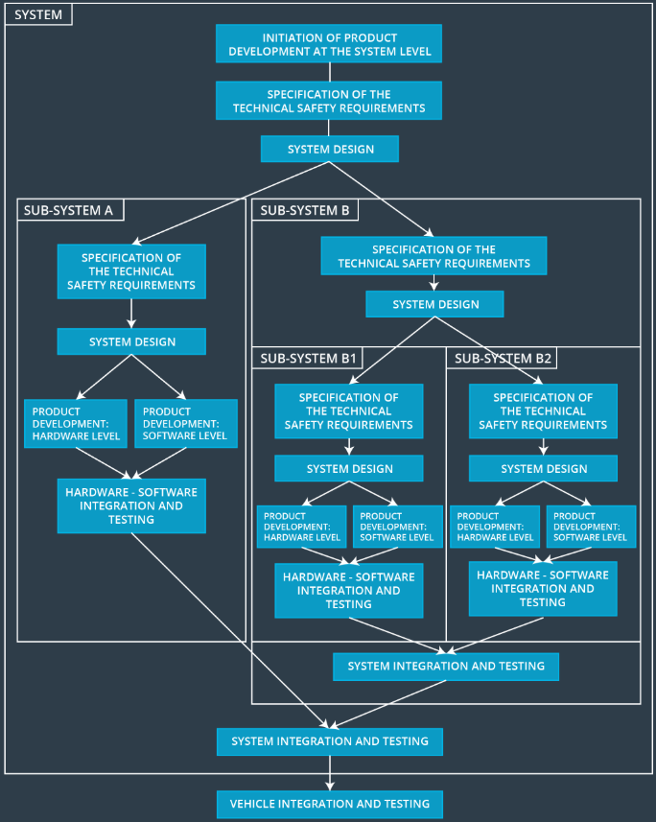
Bird’s Eye View
Figure shows a general outline of what would be involved in a functional safety project. You can see that the steps of the V model have been stretched out vertically. Oftentimes an item will have multiple systems and subsystems. Subsystems will have their own software and hardware requirements. And these subsystems need to be integrated into larger systems:
Notes:
Please note that the "in-context" development described here can become impractical due to a need to development custom software and hardware. To mitigate this, a commonly used approach is "Safety Element out of Context" (SEooC), which considers using standard safety hardware and software components to address functional safety implementation. You may enjoy this interesting paper describing a practical approach to SEooC.

Slide 70
Programming Languages
Popular languages: C, C++, Matlab (with automatic code generation to C/C++)
Software development guidelines
MISRA C, MISRA C++ specify a subset of C or C++ for safety-critical applications, including
Defensive implementation techniques
Language subsets
Style guides
Naming conventions
(MISRA stands for Motor Industry Software Reliability Association)

Slide 71
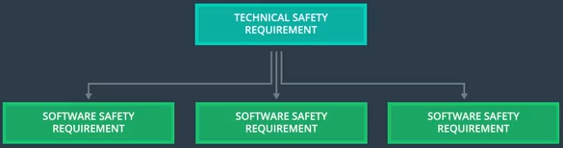
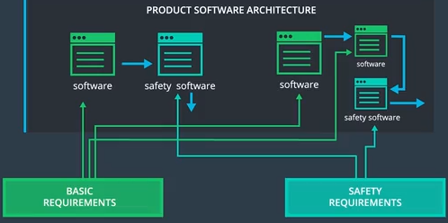
Software Safety Requirements
Software Safety Requirements are derived from Technical Safety Requirements, and allocated to software architecture elements.

Slide 72
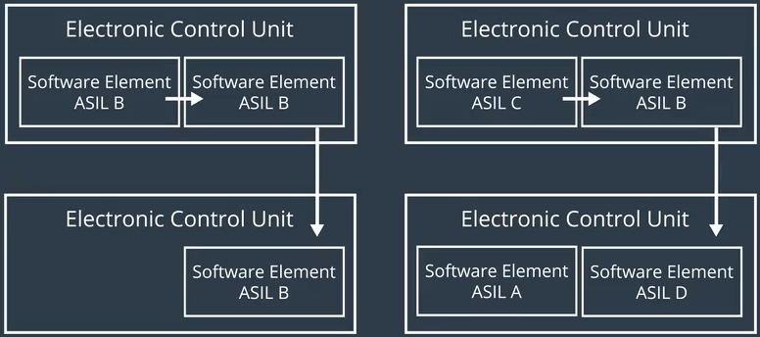
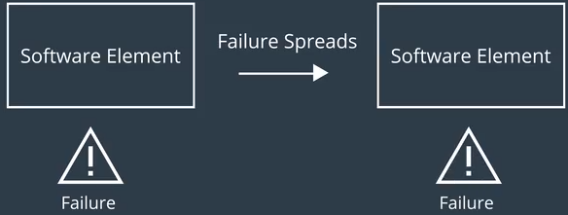
Freedom from Interference
Freedom from interference refers to the requirement that failure in one software element does not spread and cause failure in other software elements that communicate with it, or run on the same ECU.
May be between software elements with the same ASIL, or different ASILs
Interferences include
Spatial
Temporal
Notes:
- Temporal

Slide 73


Spatial Interference
Memory address spaces of software elements should be partitioned.
A counter-example: a software element (QM) has a bug that creates a pointer to the memory address space of a software element (ASIL C), and writes to it, leading to safety goal violation.

Slide 74



Temporal Interference
Top: Blocking of execution due to shared data
Middle: deadlock due to circular waiting:
Software element A is holding Resource A and requesting Resource B; Software element B is holding Resource B and requesting Resource A
Bottom: incorrect sensor fusion due to incorrect clock synchronization between software elements

Slide 75



More Temporal Interference
Incorrect allocation of execution time & incorrect execution of sequence
Top: Alive supervision checks # times a software element is executed in a time span. (In the fig, 3 is correct, 2 or 4 is not)
Middle: Deadline monitoring checks if a software element is executed before its deadline
Bottom: Control Flow Monitoring checks that software elements are executed in the correct sequence

Slide 76


Communication Interference and End-to-End Protocol
Communication channels between ECUs often have QM level, hence data transmission errors on the channel are possible.
E2E protocol can be used to detect errors due to transmission errors.
e.g., with CRCs (Slide 56)

Slide 77


Software Architecture Safetey Design Pattern: E-Gas
Top: the E-Gas architecture with 2 levels of monitoring for the functional level.
Bottom: if Level 2 monitoring detects a safety goal violation, output from level 1 is disabled, and Level 2 software leads the system to a safe state by setting Torque = 0.

